Slide 1
Notes:
The days of the early church saw innumerable Christians lose their life in the most deplorable and heinous ways. You were lucky if you were beheaded. But most deaths were by torture and included being torn to pieces by lions in the coliseum, cooked alive, burned alive, dragged to death behind chariots, skinned alive, sewn into animal skins and eaten alive by dogs, starved to death, boiled to death in oil, ground to death on a mill, put through breaking wheels, and having their guts eaten by pigs. But the worst torture was crucifixion, of which some were tortured right-side up, upside down, and even sideways.
Persecution was not discretionary. Men, women, and even children suffered these fates. And those loved ones left behind endured the emotional agony even as they knew their loved ones had moved on to their reward.
As we consider the persecution of the early church, we’re going to see the reasons why it happened as well as the outcome. There were a lot of great things that came out of the suffering of the early Christians. And there were also some bad things. We’ll take an honest approach to this subject and consider both ends.

Slide 2
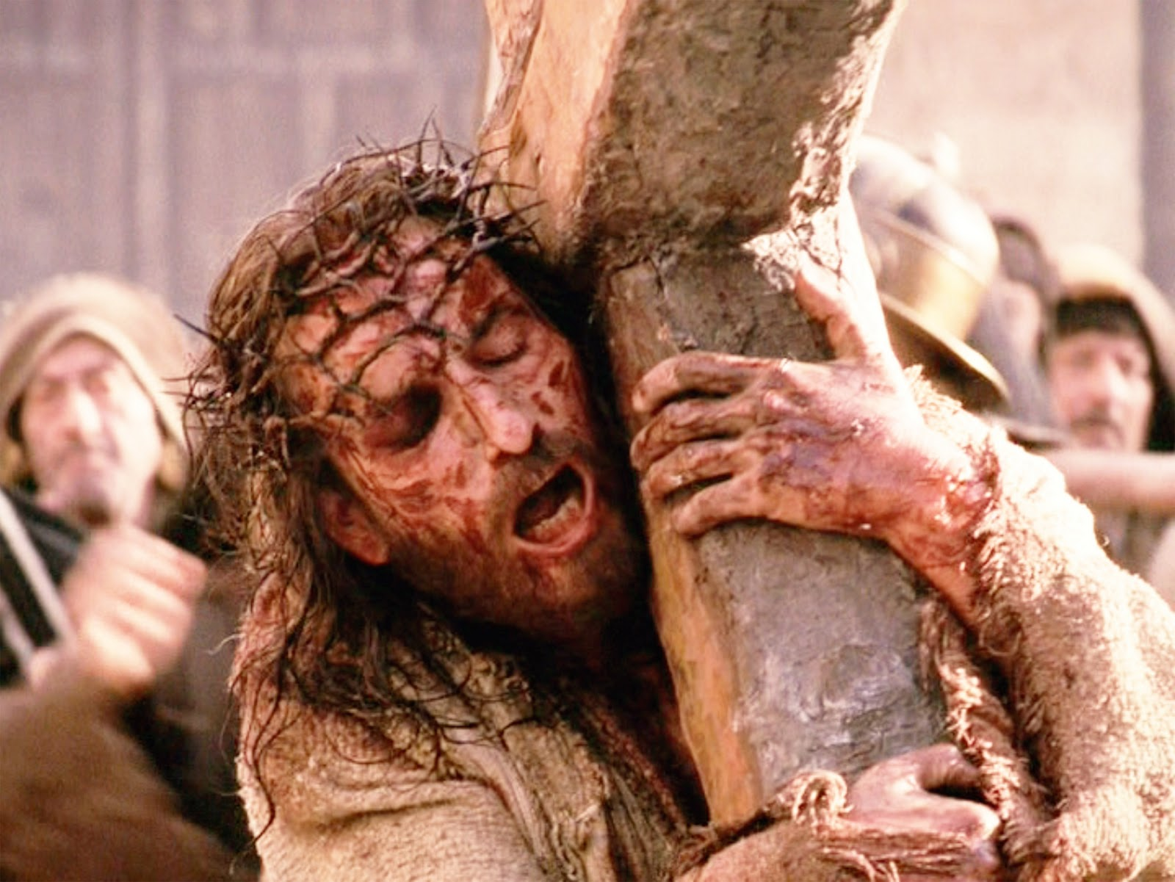
Persecution Predicted
John 15:18-20 – “¹⁸If the world hates you, you know that it has hated Me before it hated you. ¹⁹If you were of the world, the world would love its own; but because you are not of the world, but I chose you out of the world, because of this the world hates you. ²⁰Remember the word that I said to you, ‘A slave is not greater than his master.’ If they persecuted Me, they will also persecute you; if they kept My word, they will keep yours also.
Notes:
It’s important to note that in the week before His death, Jesus assured the apostles that his followers would be persecuted. In fact, he made sure they understood that a Christian’s faith would be relative to the amount of suffering they experienced as result of following Him. “If they persecuted Me, they will also persecute you.” In other words, it is impossible to follow Jesus as fully and wholly as we should without us suffering a measure of the persecution that He Himself endured.

Slide 3
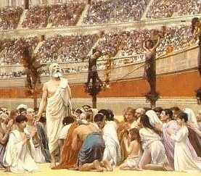
Persecution Predicted
Matt 23:34 – “Therefore, behold, I am sending you prophets and wise men and scribes; some of them you will kill and crucify, and some of them you will scourge in your synagogues, and persecute from city to city…”
Luke 11:49 – “For this reason also the wisdom of God said, ‘I will send to them prophets and apostles, and some of them they will kill and some they will persecute…’”
Notes:
Jesus not only identifies those who would suffer, but also those who would instigate it. The Pharisees, and those like them, would kill and crucify prophets and wise men. These are people who do not have good hearts; they are set in their ways and do not want to change. And so when Christians went about from city to city preaching the gospel, they resented and hated them for it. This persecution would not be isolated to any one place, but would extend from city to city throughout the entirety of the Roman Empire.

Slide 4
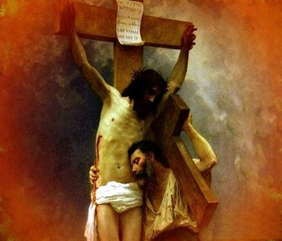
Persecution Predicted
Acts 14:22b – “Through many tribulations we must enter the kingdom of God.”
2 Tim 3:12 – “Indeed, all who desire to live godly in Christ Jesus will be persecuted.”
1 Pet 2:21 – “To this you were called, because Christ suffered for you, leaving you an example, that you should follow in his steps.”
Notes:
When Paul planted churches, one of the messages he delivered to them by way of edification and strengthening was to remind them they would face tribulation upon entering God’s kingdom. In his letter to Timothy, he extends this message by reminding them that all who desire to live godly will be persecuted. This is an inescapable conclusion of true godliness rendered by those who wish to pitch their tents in darkness. Worldly men will resent those who live by principle and not passion. Christian’s who follow Christ will suffer.

Slide 5
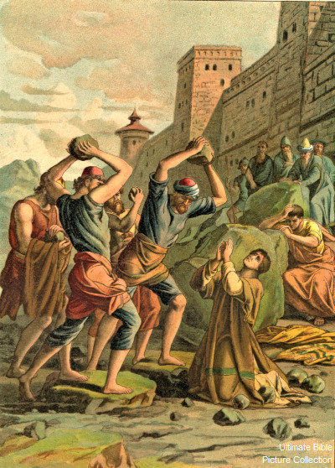
Persecution Realized
Killed
Stephen killed: Acts 7:54-60
James killed: Acts 12:1-2
Imprisoned
John & Peter: Acts 4:3
Apostles: Acts 5:18
Many Christians: Acts 8:3
Peter: Acts 12:3-18
Paul & Silas: Acts 16:22-24
Paul: Acts 22 - 28
Notes:
Before the end of the apostolic age, we see persecution realized in scripture. The unbelieving Jews were the first to persecute Christians. Stephen becomes the first martyr for daring to speak out against the “party” and exposing their sin and hypocrisy. The apostle James was killed with the sword by the hateful king Herod. Many more were imprisoned merely for preaching the gospel and caring for lost souls. These were men whom the world was not worthy (Heb 11:38) who risked their lives to save mankind from eternal damnation. Their joy and reward was being counted worthy to suffer as their Lord had.

Slide 6
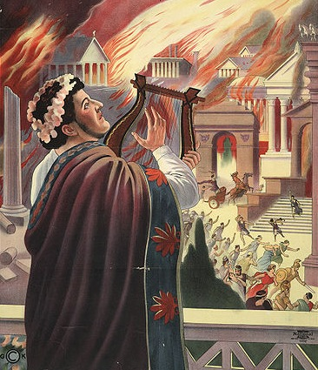
Persecution to 100AD
Nero: first persecutor (64 AD)
Fire in Rome for 6 days/nights
Nero started; blamed Christians
Christians were:
Crucified
Sewn up in skins of wild beasts; dogs were set loose to tear them to pieces
Women were tied to mad bulls and dragged to death
At nightfall, Christians were burned at the stake in Nero’s garden to provide light
Apostle Peter crucified upside down; Paul beheaded
Notes:
After the Jews persecution came persecution from the Romans. Up until ~250AD, Christian persecution by the Romans was not continuous. A long period occurred between 64AD and 250AD where Christians lived in relative peace and harmony with others. But when persecution did hit during this time, it hit hard.
Rumors swirled that the great fire that burned 2/3 of Rome was begun by Nero in order to realize his dream of rebuilding Rome in his image. To take away attention from himself, he began to blame Christians as he saw them as easy targets. Many Christians suffered and died merely because Nero wanted to save face. Two of the most beloved Christians of all time were also martyred during his reign: the apostles Peter and Paul.
During this time, Christians were gracious, prayerful, and joyous in their persecution. They never once cursed or blasphemed Nero or his executioners. This led the common man to realize men and women of this caliber of character could not possibly be responsible for what Nero accused them of. This put the attention back on Herod who eventually was forced to perform his own suicide. He was such a coward that someone else had to kill him.

Slide 7
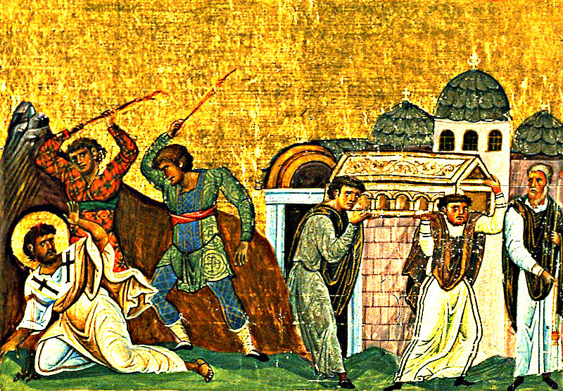
Persecution to 100AD
Domitian (95 AD)
Jews refused to pay a toll tax levied for the support of the Temple of Jupiter
Because Christians were associated with Jews, they felt the emperor's wrath
Commanded the “lineage of David” to be put to death
“No Christian, once brought before the tribunal, should be exempted from punishment without renouncing his religion."
Blamed Christians for famine, pestilence, and earthquakes
Apostle John banished to Patmos (history claims he was boiled in oil beforehand)
History claims Timothy killed (beaten w/clubs)
Notes:
Domitian was the second Roman emperor to begin persecuting Christians. History tells us that the Jews refused to pay a tax that was levied by the Romans was earmarked for the Temple of Jupiter. As a result, Domitian commanded all of the line of David to be exterminated. Christians were included in this persecution because of their similarities and association with the Jews. The law was written that “no Christian, once brought before the tribunal, should be exempted from punishment without renouncing his religion.” Christians were falsely accused (again) of being responsible for the recent famines, pestilences and earthquakes because the Romans thought the “gods” were being neglected by them and getting angry. It was during this persecution that John was banished to Patmos and Timothy was killed.

Slide 8
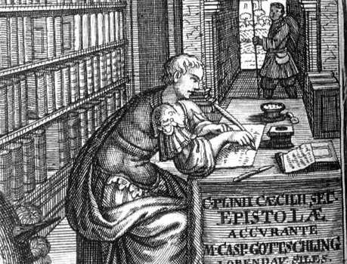
Persecution from 100 – 250 AD
Pliny the Younger, Governor of Bithynia (112 AD)
First organized persecution – Christians brought to court
Pliny wrote to Emperor Trajan of his procedure of treating Christians
Christians could not be sought out, only reported
Christians were punished if they did not recant their faith
Ignatius thrown to wild beasts in Rome
Notes:
In 112 AD, Pliny, governor of Bithynia, wrote letters to the emperor Trajan calling his attention to a problem that been created in his district by the increasing number of Christians. He called Christianity a “superstition” and expressed concern because the temples of the heathen gods were being forsaken as a result of the number of conversion taking place. Those who made their living by selling animals to be sacrificed in these temples to the heathen gods had suffered great loss in business. Therefore Pliny asked for advice from Trajan on how these Christians were to be treated.
Trajan replied that they were to be left alone unless specifically given up by accusers who could name them. If convicted, they should be given opportunity to renounce the Christian faith. If they refused, they were to be punished. This seems lenient on the surface, but it provided opportunity for unscrupulous men to falsely accuse and testify against Christians.

Slide 9
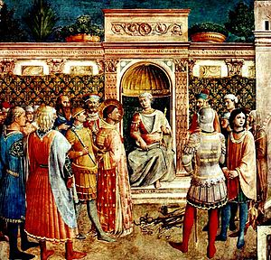
Persecution from 100 – 250 AD
Marcus Aurelius (161 – 180 AD)
Devout stoic taught by his teacher Fronto to despise Christians
Determined to restore ancient Roman customs and practices
Decreed Christians’ property be given to their accusers
Like Domitian, blamed natural and man-made calamities on Christians
Polycarp burned at the stake
“Eighty and six years have I served Him, and He has never done me wrong; how can I blaspheme Him, my King, who has saved me? I am a Christian.”
Justin Martyr scourged and beheaded in Rome w/6 others
“We desire nothing more than to suffer for our Lord Jesus Christ; for this gives us salvation and joyfulness before His dreadful judgment seat…”
Notes:
Another persecution occurred under Marcus Aurelius. He was a devout stoic taught from his youth by the philosopher Fronto who despised Christians. When he became emperor, he desired to return Rome to its ancient religious customs and practices. He regarded Christians as innovators and therefore sought to repress them by force. Some of the more cruel punishments and deaths of Christians occurred under his reign. Property was stripped from Christians and given to their accusers, which in turn emboldened the greedy to make false accusations. Like Domitian, he also blamed the natural and man-made calamities on Christians believing they were the result of the sacrifices to the false gods being neglected.
Polycarp, before his execution, asked for one hour of prayer and it was granted. He prayed with such fervency that the guards who brought him repented. Justin Martyr’s skill in apology and debate so angered his opponents, he was prejudiced against the emperor and ordered with six of his companions to be scourged and then beheaded.

Slide 10
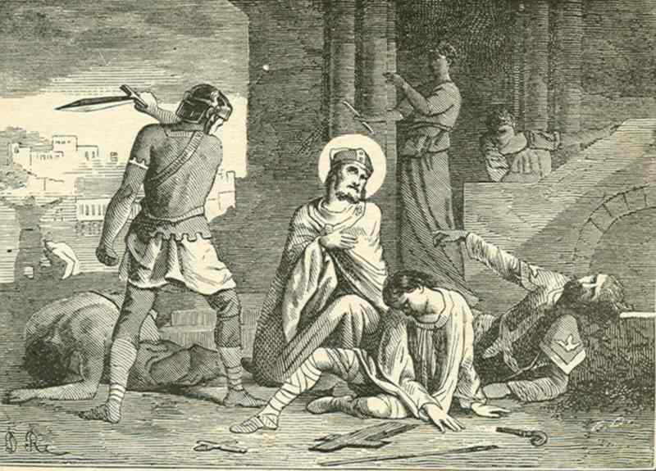
Persecution from 100 – 250 AD
Septimius Severus (200 – 211 AD)
Early in his reign, he was not unfriendly to Christians
Later influenced by prejudiced heathens
Signed edict forbidding conversion to Judaism or Christianity
Violent persecution in Alexandria
Clement of Alexandria martyred
Irenaeus martyred
Father of Origin martyred
Origin wanted to offer himself as a martyr, but his mother restrained him (hid his britches)
Notes:
Another persecution occurred under Septimius Severus. He was favorable to Christians early on but was manipulated by the ignorant and prejudiced heathens. Heathens were so angered by the growth of Christianity that they began falsely accusing Christians of any accidental misfortune that happened to occur to the empire. So Severus signed an edict in 202 forbidding any conversion to Judaism or Christianity. One of the worst persecutions occurred in Alexandria where Clement would lose his life.
Martyrdom started to become so admired by Christians that many jumped the gun in wanting to give their life. When Origin saw the Romans walking through town looking for Christians, he tried to leave his house and freely offer himself, but his mother hid his britches so he couldn’t leave the house.

Slide 11
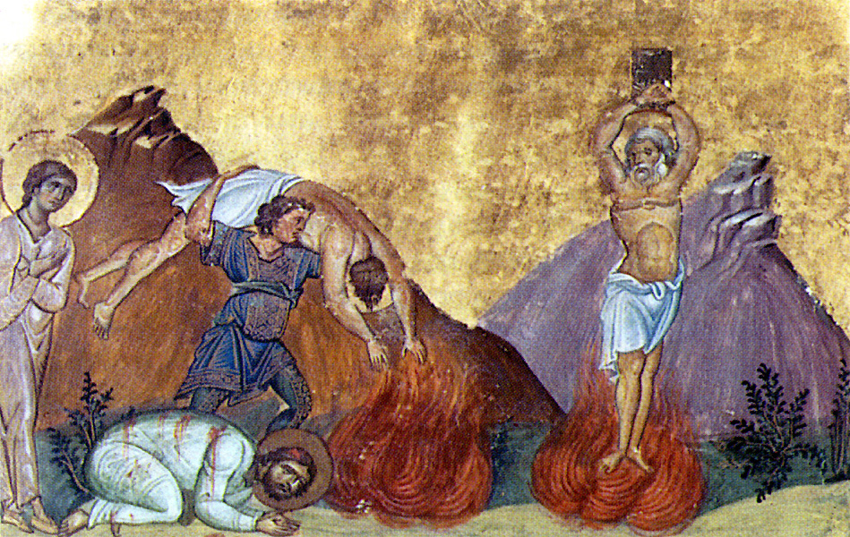
Persecution after 250 AD
Decius (249 – 251)
Issued edict in 250AD demanding sacrifices to Roman gods and the Emperor
Millennium was approaching and empire was suffering from natural disasters, internal and external attacks
Superstition led Romans to blame the Christians since they were increasing in numbers and pagans were decreasing in numbers
Some Christians gave in
Origin put to death
Notes:
250AD began the first universal persecution of the church and would last consistently until Constantine signed the Edict of Toleration in 313AD. The emperor Decius began this persecution because he issued an edict demanding that everyone within the Roman Empire sacrifice to the Roman gods and the well-being of the emperor. Decius did this because he was jealous of the growth of Christianity and the declining attendance at pagan temples. There were also superstitions about the approaching millennium.
Some Christians actually gave in to the persecution in order to avoid torture, even so far as handing over scripture to be burned and turning in their fellow Christians to the authorities. Other Christians such as Cyprian went into hiding. Others were brutally tortured and killed for refusing including Origin.

Slide 12
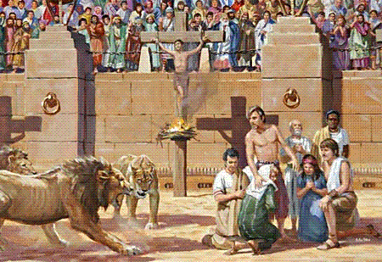
Persecution after 250 AD
Diocletian (284 – 305)
Issued edict in 303 calling for the persecution of Christians
Ordered cessation of meetings, destruction of churches, deposition of church leaders, imprisonment, and the burning of Scripture
Eusebius wrote that prisons were so crowded with Christians that there wasn’t enough room for the inmates
Christians punished by loss of property, exile, imprisonment, execution by sword or wild beasts, or sent to totalitarian camps where they worked to death in the mines
Notes:
Know as the “Great Persecution”, this was the last and most severe persecution that Christians would ever experience in the Roman Empire.
Diocletian’s reign began amidst political discord. He ended the shared authority between the emperor and senate that had been in existence since Caesar Augustus signed it in 27BC. Establishing a monarchy, he sought to eradicate any democratic elements including those religions hostile to state religion. He ordered the cessation of meeting places, destruction of churches, deposition of church leaders, imprisonment of Christians and the burning of sacred Scripture. Eusebius wrote that prisons were so crowded with Christians that there wasn’t enough room for the inmates. This great persecution would continue with other emperors until Constantine ended it.

Slide 13
Action
Reaction
The bones and relics of martyrs were sought after and idolized (veneration)
Notes:
There were two unfortunate reactions to early Christian persecution. The first was the beginning of the Catholic doctrine called “Veneration”. So admired were the courage of martyrs that they were exalted beyond their proper place. Pieces of bones and relics were sought after and admired and Christians began to take pride in the number of these items they could acquire. As time went on, it was supposed that these items gave the one acquiring them special spiritual powers. This practice became a gateway for idolatry entering the church. It’s no wonder the Lord buried Moses Himself!

Slide 14
Action
Reaction
“Donatists” disagreed with other Christians on how to handle those who gave in to persecution
Notes:
The second reaction came as a result of those Christians who gave in to persecution. During Decius’ reign, certain Christians handed over scripture to be burned and turned in fellow Christians to be martyred . When persecution ended at the signing of the Edict of Toleration by Constantine, some Christians thought they should be permanently excommunicated, especially those who had at one time been leaders in the church. Much dissension arose over how to handle this controversy and a sect split off who would not tolerate these betrayers being fellowshipped. They were called “Donatists” and they continued to cause strife amongst Christians until the Muslim conquests of the 7th and 8th centuries.

Slide 15
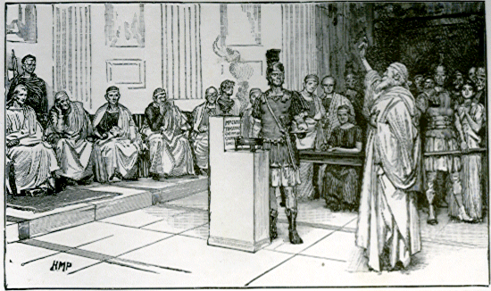
Reasons for Persecution
Political
When no longer shown to be Judaism, Romans banned it
Sovereignty of Christ vs. sovereignty of Caesar
Christians refused to offer incense on alters devoted to Caesar
Christians held meetings at night and in secret
Roman authorities viewed this as a conspiracy
Christians refused to serve as soldiers
Notes:
There were four main reasons for early church persecution. The first was political.
In the very early church, Romans were tolerant of Christianity only because they thought it was a type of Judaism. Once it was shown to be different and rumored to be a “secret society”, Romans illegalized it and considered it a threat to the state.
Secondly, since Christians worship Christ exclusively, loyalty to Caesar to took second place which was perceived by Romans to be disloyalty to the state. Christians were then accused of setting up a state within a state. Therefore it became an issue in the minds of the Roman elite as to whom as sovereign authority.
Thirdly, Christians conscientiously and consistently refused to offer incense on the alter to Caesar which caused them to be looked at as disloyal.
Fourth, Christians held most of their meetings at night and when persecution started they did so in secret. To the Roman, this looked like the hatching of a conspiracy against the state.
Fifth, Christians refused to serve as soldiers in the Roman army. This adds a often unheard of dimension to the “war question.” Christians did begin serving in the military after 313AD when Constantine signed the Edict of Toleration.

Slide 16
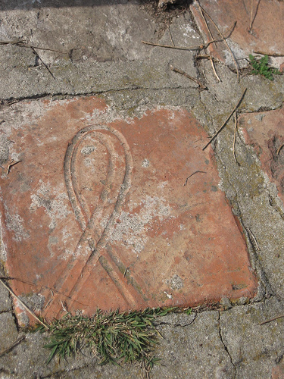
Reasons for Persecution
Religious
Romans mechanical and external religion (alters, idols, priests, etc) vs. Christians’ spiritual internal religion
Romans viewed Christians as atheists
Christians’ secret meetings led to public rumor
Incest, cannibalism, unnatural practices
Misunderstandings of the L.S. led to accusations that Christians killed/ate infants
“Holy Kiss” twisted into charges of incest and other immoral conduct
Notes:
The second reason for persecution was religious.
First, Roman idolatry was external and mechanical, emphasizing practices that people could see. Christians have no idols and very little visible paraphernalia in their worship because it is spiritual and internal. Romans therefore viewed Christians as atheists.
Second, the secrecy of Christian meetings led to vicious, false rumors by the public in an effort to stigmatize them. Misunderstandings related to the Lord’s Supper brought accusations of cannibalism. The “holy kiss” was twisted into incest and other immoral conduct.

Slide 17
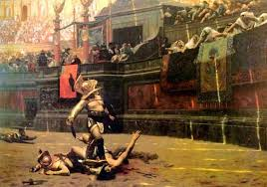
Reasons for Persecution
Social
Christians who appealed to lower classes and slaves were hated by influential aristocratic leaders
Christians upheld equality for all people (Col 3:11); paganism insisted on aristocratic structure where the privileged few were served by the lower class
Christians separated themselves from temples, theatres, and places of recreation
Deemed “haters of mankind”
Christian purity was a silent rebuke to the scandalous lives of the upper class
Notes:
The third reason for persecution was social.
First, Christianity had great appeal to the lower class which angered the aristocrats. The aristocratic elite were worried they would not longer be served by the lower class.
Second, Christians separated themselves from Roman entertainment that conflicted with moral purity. This was a silent rebuke to the conformists of that era who then deemed Christians “hater of mankind”. They feared revolt that would rob them of their carnal entertainment.

Slide 18
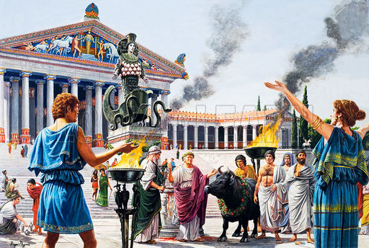
Reasons for Persecution
Economic
Livelihood of priests, idol makers, soothsayers, painters, architects, and sculptors threatened
Acts 19:23-27
When plague, famine, and civic unrest threatened Rome, Christians were blamed for leading the empire into forsaking the “gods”
Notes:
And then the fourth reason for persecution was economic.
First, those who made their living as architects, sculptors, etc. of idols felt their livelihood being threatened. The Apostle Paul dealt with this in Acts 19 when Demetrius gathered the craftsmen of Ephesus in revolt.
Second, since famine, pestilence, plague, and earthquakes started decimating the empire, popular belief was that the forsaking of the older gods, de-influenced by Christians, was the reason. Persecution of Christians seemed the logical way for them to overcome their troubles.

Slide 19
Questions For Discussion Next Week
Why does Christianity thrive in persecution?
You are on trial for Christianity. What evidence will convict you?
How should Christians handle traitors?
Notes:
Here are our questions for next week:
Why does Christianity thrive in persecution?
If you are put on trial for being a Christian, what evidence would convict you?
How should Christians handle traitors to the cause of Christ?

Slide 21
Notes:
As we study church history, we want to be careful to make sure we learn the practical applications to help us in our walk with God today. History contains more than just stories, but also action/reactions that are similar to the issues we encounter in the 21st century. Learning where early Christians succeeded and failed will help us solidify our faith.

Slide 22
Practical Applications
1) Why does Christianity thrive in persecution?
Notes:
Tertullian wrote at the end of the 2nd century that “the blood of martyrs is the seed of the church.” This counters conventional thinking that persecution and martyrdom is an obstacle to church growth. The very heart of Christianity is that by Christ’s shedding of blood, the blessing of an incorruptible life was purchased for all who believe in Him. Therefore, it was Christ’s willingness to die that compels unbelievers to pursue Him with all of their heart, mind, soul and strength.

Slide 23
Practical Applications
Why does Christianity thrive in persecution?
Courage through influence
John 12:24 – “Truly, truly, I say to you, unless a grain of wheat falls into the earth and dies, it remains alone; but if it dies, it bears much fruit.”
True Christians want to share in Christ’s suffering
Acts 5:41 – “So they went on their way from the presence of the Council, rejoicing that they had been considered worthy to suffer shame for His name.”
It fills up what is lacking in Christ’s affliction
Col 1:24 – “Now I rejoice in my sufferings for your sake, and in my flesh I do my share on behalf of His body, which is the church, in filling up what is lacking in Christ’s afflictions.”
Notes:
Fear is the #1 obstacle to both personal work and Christian growth. As Christians held fast in the very face of adversity, an “if they can do it, so can we” mentality spread amongst the saints.
The heart of Christianity is the suffering death of Jesus Christ. Every Christian desiring to share in His glory finds courage to follow Him to the cross. As more Christians gave their life for His cause, courage spread like leaven through the brotherhood
What’s missing is the in-person presentation of Christ’s sufferings to the people for whom he died. The afflictions are lacking in the sense that they are not seen and known among the nations. While Christ suffered in order to purchase our eternal life, Christians follow Him in suffering in order to spread the effects of that fully-accomplished redemption. Without suffering and martyrdom, the effects of Christ’s great success can never be fully realized. The effects of Christ’s suffering is carried out by ministers of the gospel who extend a willingness to suffer for others. Paul sees his own suffering as the visible reenactment of the sufferings of Christ so that they will see Christ’s love for them.

Slide 24
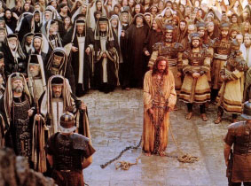
Practical Applications
2) You are on trial for Christianity. What evidence will convict you?
Notes:
In other words, do people in the world know you well enough to know what you stand for? Does your demeanor, character, language, clothing, and associations align you with Christ or with the world? When freedom of religion is no longer available in our society and the government is kicking down church doors, will you be the first or last taken?

Slide 25
Practical Applications
2) You are on trial for Christianity. What evidence will convict you?
Gathering with Saints
Acts 2:46– “Day by day continuing with one mind in the temple, and breaking bread from house to house, they were taking their meals together with gladness and sincerity of heart”
Public Praying & Studying
Dan 6:10 – “Now when Daniel knew that the document was signed, he entered his house (now in his roof chamber he had windows open toward Jerusalem); and he continued kneeling on his knees three times a day, praying and giving thanks before his God, as he had been doing previously.”
Evangelizing
Matt 14:3-4 – “³For when Herod had John arrested, he bound him and put him in prison because of Herodias, the wife of his brother Philip. ⁴For John had been saying to him, “It is not lawful for you to have her.””
False Reports
Acts 24:6a – “And he even tried to desecrate the temple…”
Mark 15:29 – “Those passing by were hurling abuse at Him, wagging their heads, and saying, “Ha! You who are going to destroy the temple and rebuild it in three days”
Notes:
Some people do not see the necessity of gathering with the saints at every opportunity. But in the early church, Christians were known by their assembling together and it occurred almost daily. If my mentality is, “I don’t ‘have’ to go to every service than the world authorities might not know that you are a Christian
Daniel, despite the law, continued his prayers to God in plain view of everyone knowing it could very well lead to his martyrdom. Yet He approached God in prayer with such singleness of mind that it did not matter to him what others thought – it only mattered that he revere God. While many Christians in the early church did not escape such persecution with their lives as Daniel did, their devotion to God in study and prayer had a tremendous impact on the Roman community even though such public devotion led to their deaths.
Its often fear of a person’s response that keeps us from telling people the truth. The early Christians were known for not pulling punches when it came to the gospel. Many such as Stephen, Paul, and others lost their lives because they could not remain silent. Like Jeremiah, the word was a fire in their heart that could not be contained.
If you are living a pure life, abstaining from carnal enticements, those of the world will resent you for it because it will stand as a silent rebuke to their lifestyle. As with the early Christians, it is inevitable false charges will be brought up against you. It is unavoidable for all who desire to live godly lives.

Slide 26
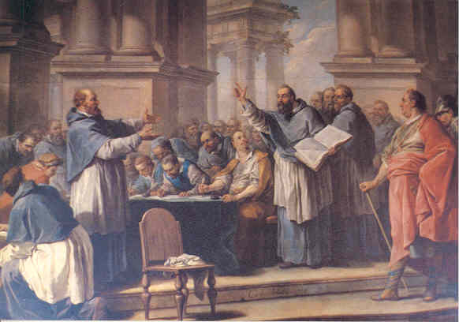
Practical Applications
3) How should Christians handle traitors who repent?
Notes:
Donatists separated from the church because they rejected fellowship with those Christians who renounced Christ during persecution. In our day and age, Christians sometimes commit heinous acts (adultery, murder, rape, etc.). What should be our response when they repent? To what degree should they be allowed to participate in worship? What if the Christians in question are elders, deacons, or preachers?

Slide 27
Practical Applications
3) How should Christians handle traitors who repent?
They should be forgiven and welcomed into fellowship
Luke 17:3-4 – “³Be on your guard! If your brother sins, rebuke him; and if he repents, forgive him. ⁴And if he sins against you seven times a day, and returns to you seven times, saying, ‘I repent,’ forgive him.”
Be conscious of fruit borne from repentance
Matt 3:8 – “Therefore bear fruit in keeping with repentance”
Be proactive in strengthening the restored Christian
Gal 6:1-2 – “¹Brethren, even if anyone is caught in any trespass, you who are spiritual, restore such a one in a spirit of gentleness; each one looking to yourself, so that you too will not be tempted. ²Bear one another’s burdens, and thereby fulfill the law of Christ.”
Encourage testimony
1 Cor 15:10 – “But by the grace of God I am what I am, and His grace toward me did not prove vain; but I labored even more than all of them, yet not I, but the grace of God with me.”
Notes:
No matter how horrible the sin, the blood of Jesus I powerful enough to wash it away. We need to believe in that power and accept a penitent person as God accepts him. Be on guard against letting the emotional trauma of certain sins distract and embitter us from forgiving others as God forgives our own sin.
Confession and repentance should always be followed by fruit borne from that repentance. While it is necessary to receive the penitent back into fellowship, it is not unreasonable to expect real change to take place as the old man is put back to death and the new man becomes further visible.
The penitent will no doubt struggle with the same weaknesses that caused him/her to sin in the first place. This requires our help, sympathy, empathy, and bearing of their burdens. Sins of the magnitude we are discussing are not beaten alone, but need the attention of brothers and sisters.
Paul is a perfect example of someone who was not ashamed to preach his testimony which included the sins he had committed. The Holy Spirit thought his conversion was important enough to record it for us in Acts 3 separate times. Likewise, Christians recovering from sins of the magnitude under consideration can inspire others to purity and self-control by their own testimony, first-hand experience with sin, and personal suggestions on abstaining.

